Slide 1
Pablo Picasso The Father of Cubism

Slide 2
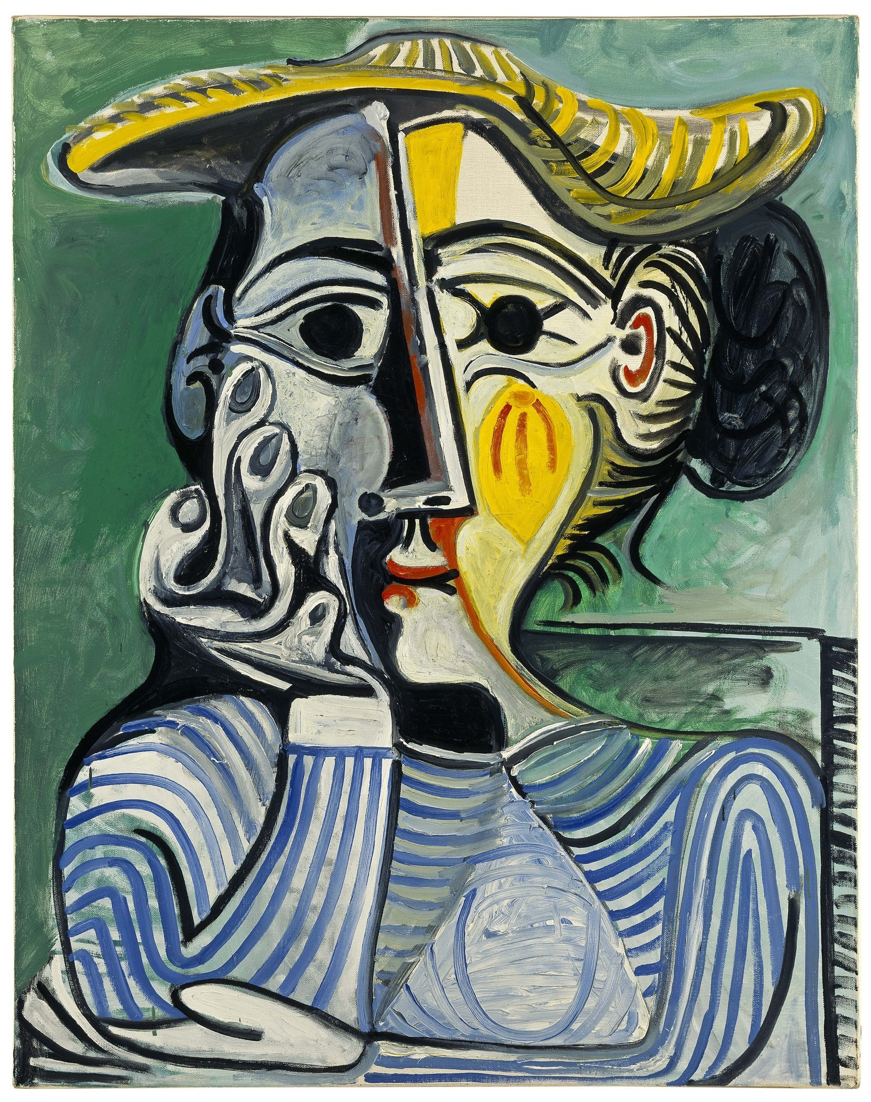
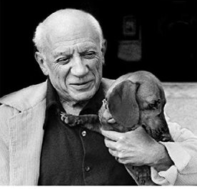
Picasso Portraits
Pablo Ruiz y Picasso was born on October 25, 1881, in Málaga, Spain. He learned to draw from his father, a professional art teacher.
Pablo Picasso experimented with many different styles of painting during his long career as an artist. His work was a major influence on the development of modern art. Picasso also created sculpture, prints, pottery, poetry, and theatre scenery.
Picasso continued to work into his 90s. He died on April 8, 1973, in Mougins, France.
His full name is Pablo Diego José Francisco de Paula Juan Nepomuceno María de los Remedios Cipriano de la Santísima Trinidad Ruiz y Picasso. His Dog was named Lump.

Slide 3
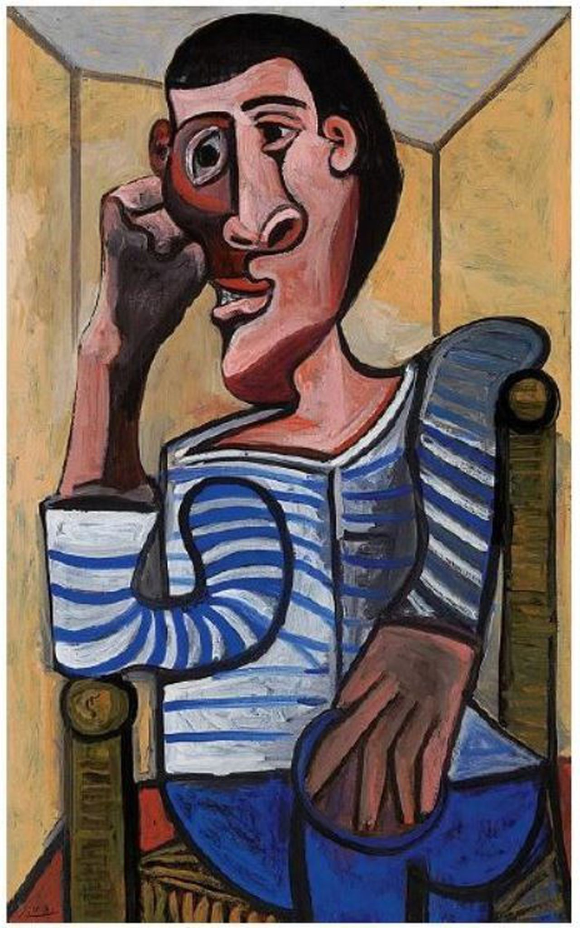
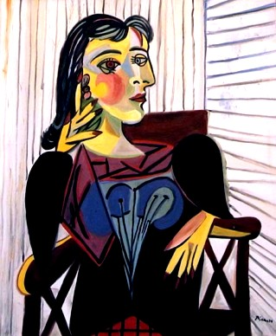

Slide 4
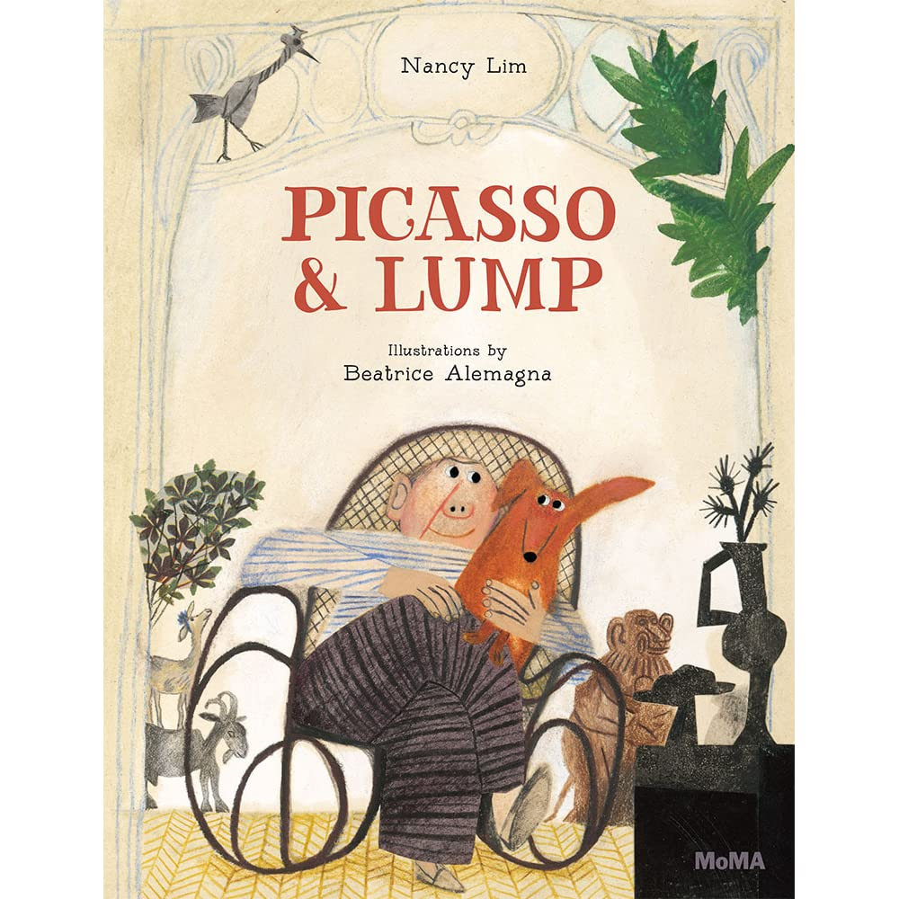
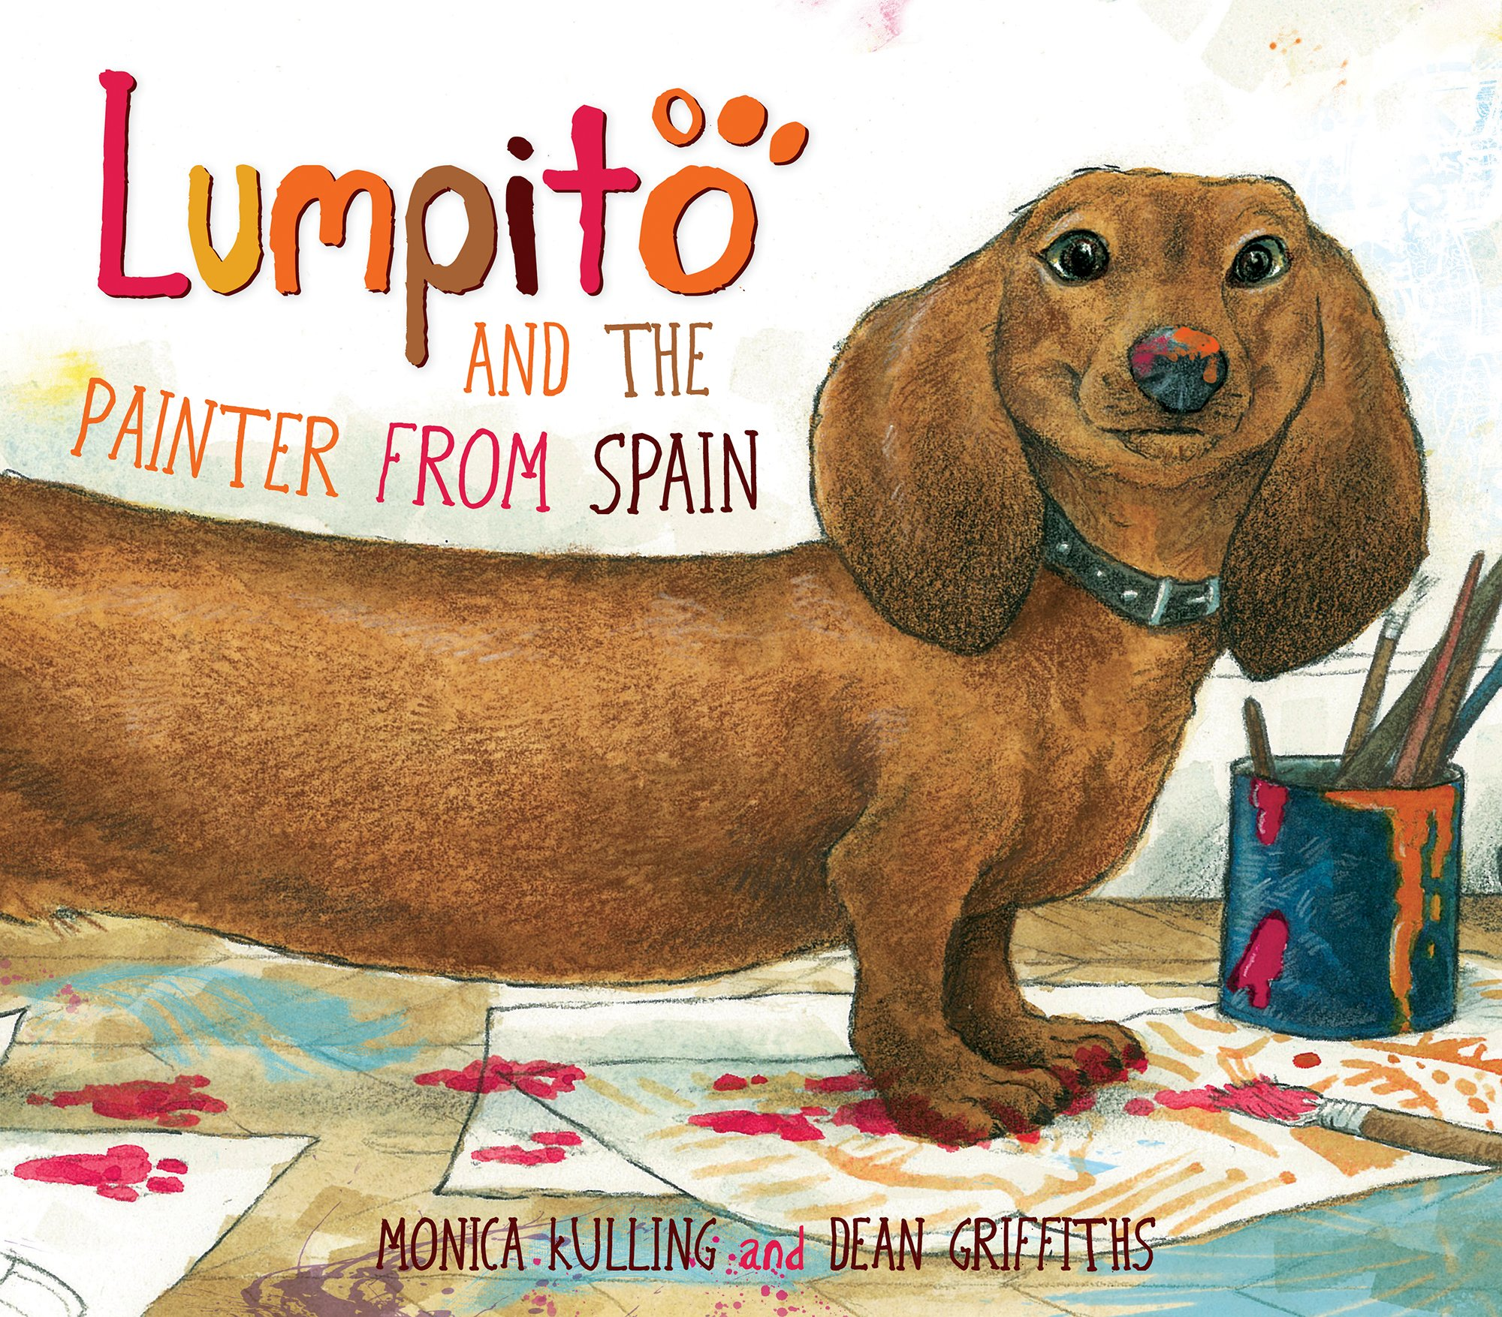
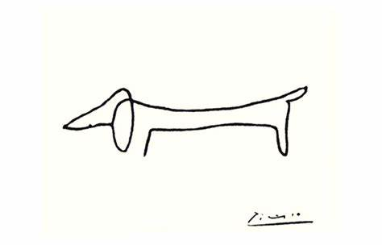
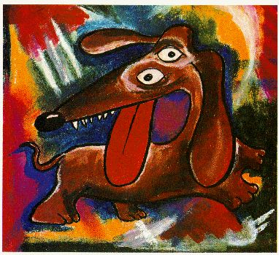
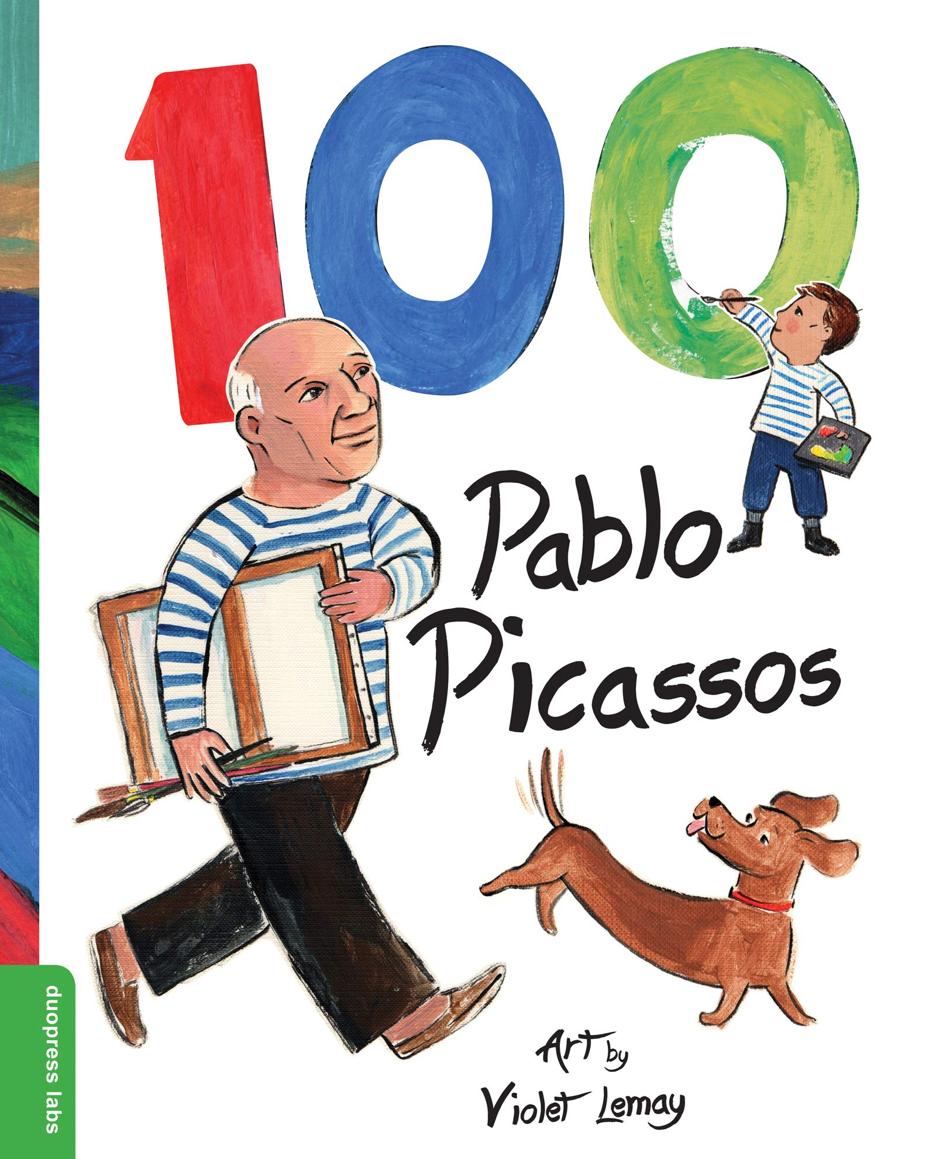
There are many books written about Picasso. Some of the stories are about his best-friend, Lump.
Click on the painting of Lump to hear the song “Picasso & Lump”

Slide 5
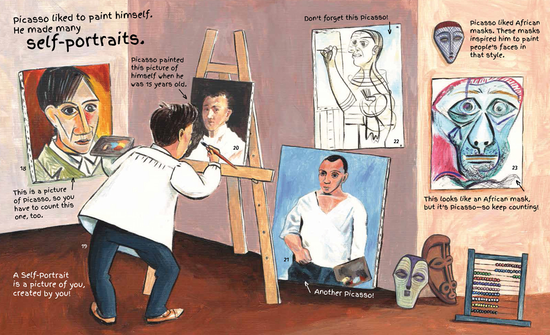

Slide 6
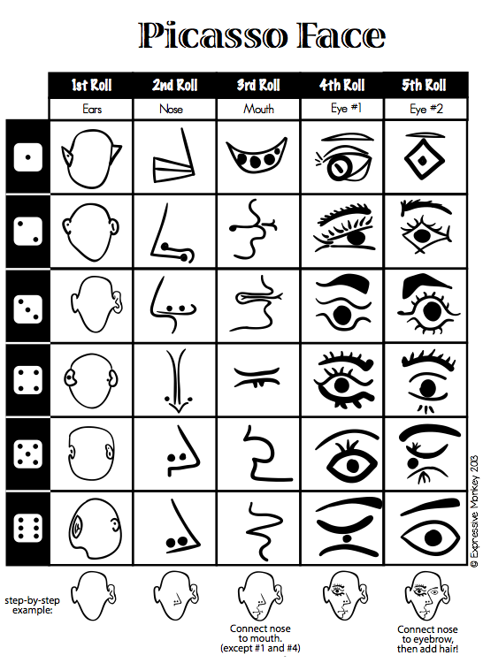
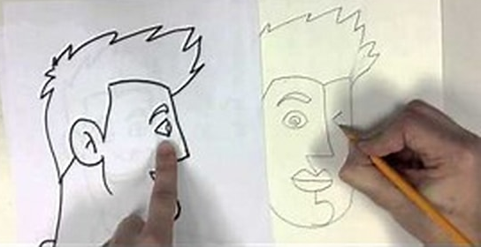
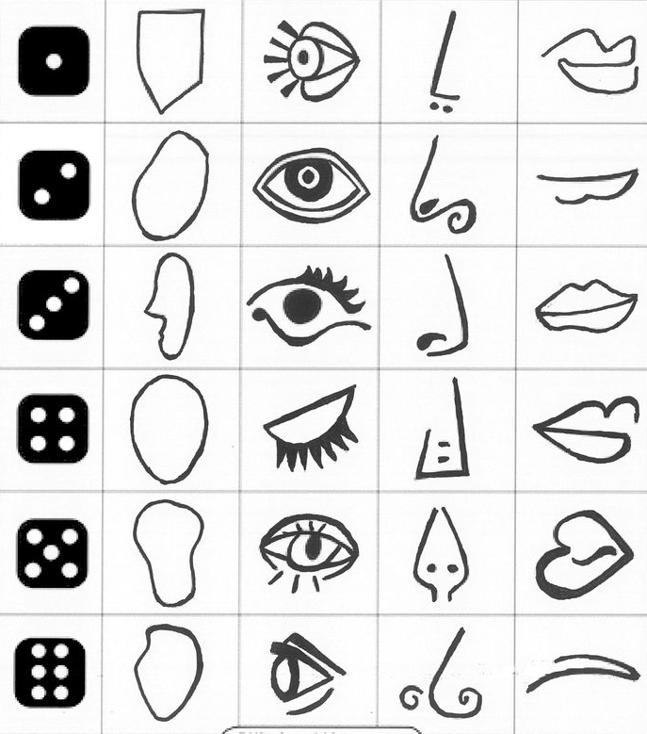
Activity:
Create your own Picasso Portrait using the Cubist Facial features for inspiration.
1. Start with the head and draw the side view including the nose and mouth. Then add the front view.
2. Add the eyes and ears. Don’t worry about making them the same size or style.
3. Finish adding the hair, the neck and shoulders and use overlapping when needed.
4.If you have room, add an arm and set your person in a chair.
Finally color your portrait.
Step by step drawing video

Slide 7
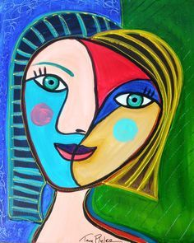
How did you do?
Did you use Cubist Facial Features?
Are the shapes neatly Drawn?
Did you draw a FRONT view and a SIDE View?
Did you draw BIG? If you drew SMALL, did you add shoulders, arms and chest?
Did you fill the space with color? Did you add a background?

